Slide 1
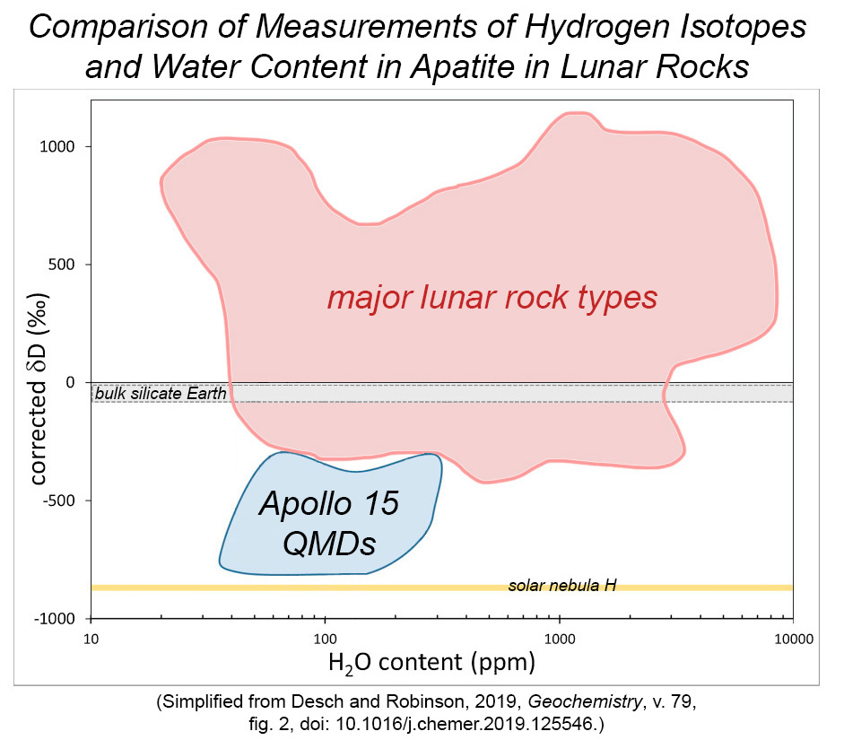
Hydrogen Isotopes in Small Lunar Samples Provide Clues
to the Origin of the Earth and Moon
Apollo 15 QMD samples have exceptionally low D/H ratios (see blue-shaded area in the plot), distinctly lower than other types of lunar rocks (red-shaded area).
The QMD values are almost as low as the δD value of the solar nebula (shown by yellow-shaded band). Low D/H ratios of QMDs indicate that a distinctive region of the lunar mantle might contain materials from planetary bodies large enough to trap gas from the solar nebula.
How was this unusual hydrogen component added to the Moon?
Researchers Desch and Robinson suggest that it was delivered by the collision between the proto-Earth and the Moon-forming impactor, often called Theia.
Apollo 15 samples that cooled slowly and crystallized in magma chambers below the lunar surface are called "quartz monzodiorites”, nicknamed QMDs.
Notes:
Overview: Small samples of igneous rocks from the Moon have low deuterium/hydrogen ratios, indicating that some planetary bodies involved in the formation of the Earth and Moon trapped gas from the solar nebula.
Summary: A prominent difference between Earth and the Moon is that one of them has lots of water, making it look like a pale blue dot when viewed from space, and the other is a gray, dusty place. The difference is almost certainly due to how the two bodies formed. Steven Desch (Arizona State University) and Katharine Robinson (Lunar and Planetary Institute, TX) used the abundances of hydrogen isotopes (hydrogen and deuterium) to probe the sources of water in the Moon and Earth. Most of the hydrogen in both bodies has a deuterium/hydrogen ratio of about 150 parts per million (not much deuterium). Most, but not all. Slowly-cooled igneous rocks (called quartz monzodiorites, QMDs for short) from the Apollo 15 landing site on the Moon have D/H of 40 parts per million, much lower than Earth and carbonaceous chondrites (about 140 parts per million). Desch and Robinson suggest that the low D/H in the QMDs indicate that low D/H regions exist inside the Moon, perhaps reflecting batches of lunar raw materials that had acquired hydrogen from the inner solar nebula (the disk of gas and dust surrounding the infant Sun), which had D/H of about 20 parts per million. This acquisition of solar nebula hydrogen could have taken place in planetary bodies large enough (about 40% of the final mass of the Earth) to form an atmosphere of nebula gas, some of which dissolved into the molten body. This scenario has implications for the nature of the giant impact that formed the Moon.
Reference: Desch, Steven J. and Robinson, Katharine L. (2019) A Unified Model for Hydrogen in the Earth and Moon: No One Expects the Theia Contribution, Geochemistry, v. 79, doi: 10.1016/j.chemer.2019.125546.
Explainer: The D/H is expressed by a derived parameter called delta D, δD. This parameter uses the D/H ratio in a planetary sample compared to standard mean ocean water (SMOW): δD = [(D/H)_{planet}/(D/H)_{SMOW} - 1] x 1000. This results in a useful measure of variations in D/H in parts per thousand.
Figure Caption: Plot of δD versus the hydrogen content (expressed as the equivalent amount of H₂O) in apatite crystals in lunar rocks. The QMD samples (blue-shaded area) form a distinct region on the diagram, characterized by low δD. The lowest values approach that of the solar nebula (yellow band). The red-shaded area shows the spread of data from other types of lunar rocks. The bulk Earth is shown by the gray band. The big spread among lunar samples is caused by variations in δD in the interior and in the case of mare basalts and KREEP basalts loss of hydrogen during eruption onto the lunar surface.

Slide 2
Hydrogen Isotopes in Small Lunar Samples Provide Clues
to the Origin of the Earth and Moon
The Desch-Robinson model is an excellent illustration of how measured geochemical data can be combined with models of planet formation and the chemistry inferred for the solar nebula to test ideas for how the Moon formed.
Four-stage overview of the model of how water with ultra-low D/H occurs in pockets inside the Moon.
Stage 1 — Initial Conditions
Notes:
Figure Caption: Stage 1 — Initial Conditions The story starts with two planetary bodies, called Theia and Proto-Earth, destined to crash into each other, each having formed a metallic core. They would have grown from smaller planetesimals, with the proto-Earth's water-budget dominated by water like that in carbonaceous chondrites and Theia's water dominated by water like that in enstatite chondrites. Measurements of water contents and D/H in enstatite chondrites vary widely, so there is some uncertainty in these initial values. The planetary bodies had to have formed rapidly in order to reach sizes large enough to accumulate an atmosphere while the solar nebula was still present. The nebula dissipated within about 3 million years of the formation of our Solar System.
Reference: Desch, Steven J. and Robinson, Katharine L. (2019) A Unified Model for Hydrogen in the Earth and Moon: No One Expects the Theia Contribution, Geochemistry, v. 79, doi: 10.1016/j.chemer.2019.125546.

Slide 3
Hydrogen Isotopes in Small Lunar Samples Provide Clues
to the Origin of the Earth and Moon
The Desch-Robinson model is an excellent illustration of how measured geochemical data can be combined with models of planet formation and the chemistry inferred for the solar nebula to test ideas for how the Moon formed.
Four-stage overview of the model of how water with ultra-low D/H occurs in pockets inside the Moon.
The Desch-Robinson model is an excellent illustration of how measured geochemical data can be combined with models of planet formation and the chemistry inferred for the solar nebula to test ideas for how the Moon formed.
Four-stage overview of the model of how water with ultra-low D/H occurs in pockets inside the Moon.
Stage 2 — Planet Evolution
Notes:
Figure Caption: Stage 2 — Planet Evolution Solar nebula gas is captured by both Theia and Proto-Earth. The gas is composed mostly of hydrogen, which dissolved in the molten silicate mantle, a process that cosmochemists call ingassing. Because the hydrogen has a very low D/H ratio, dissolution of the nebula hydrogen lowers the δD in the mantles of both bodies, but more so in Theia because of its smaller initial amount of H₂O. An interesting additional effect is that considerable silicon (Si) is reduced in Theia because the enstatite chondrite starting material is so reducing and hydrogen (also a reductant) was added to it. This also raises the amount of iron left in the silicate mantle. The δD in parts of the Earth could have been as low as -220 parts per thousand, not unlike regions identified by work on basaltic lavas derived from the deep mantle (see PSRD article: Primeval Water in the Earth. www.psrd.hawaii.edu/Nov15/Earth-primeval-water.html
Reference: Desch, Steven J. and Robinson, Katharine L. (2019) A Unified Model for Hydrogen in the Earth and Moon: No One Expects the Theia Contribution, Geochemistry, v. 79, doi: 10.1016/j.chemer.2019.125546.

Slide 4
Hydrogen Isotopes in Small Lunar Samples Provide Clues
to the Origin of the Earth and Moon
The Desch-Robinson model is an excellent illustration of how measured geochemical data can be combined with models of planet formation and the chemistry inferred for the solar nebula to test ideas for how the Moon formed.
Four-stage overview of the model of how water with ultra-low D/H occurs in pockets inside the Moon.
The Desch-Robinson model is an excellent illustration of how measured geochemical data can be combined with models of planet formation and the chemistry inferred for the solar nebula to test ideas for how the Moon formed.
Four-stage overview of the model of how water with ultra-low D/H occurs in pockets inside the Moon.
Stage 3 — Giant Impact
Notes:
Figure Caption: Stage 3 — Giant Impact Desch and Robinson considered two cases of the Giant Impact model. In one case, called merger (developed by Robin Canup, Southwest Research Institute, Boulder), the metallic cores merge and the mantles mix substantially. In the other case nicknamed hit and run (developed by Andreas Reufer, University of Bern, Switzerland, and colleagues), the mantles mix and the cores merge, but some of Theia is lost.
Reference: Desch, Steven J. and Robinson, Katharine L. (2019) A Unified Model for Hydrogen in the Earth and Moon: No One Expects the Theia Contribution, Geochemistry, v. 79, doi: 10.1016/j.chemer.2019.125546.

Slide 5
Hydrogen Isotopes in Small Lunar Samples Provide Clues
to the Origin of the Earth and Moon
The Desch-Robinson model is an excellent illustration of how measured geochemical data can be combined with models of planet formation and the chemistry inferred for the solar nebula to test ideas for how the Moon formed.
Four-stage overview of the model of how water with ultra-low D/H occurs in pockets inside the Moon.
The Desch-Robinson model is an excellent illustration of how measured geochemical data can be combined with models of planet formation and the chemistry inferred for the solar nebula to test ideas for how the Moon formed.
Four-stage overview of the model of how water with ultra-low D/H occurs in pockets inside the Moon.
Stage 4 — Final Products
Notes:
Figure Caption: Stage 4 — Final Products In both scenarios for the giant impact, the Moon ends up with less H₂O and lower average δD than does the Earth because the hypothesis assumes that Theia is large enough to ingas substantial amounts of nebula hydrogen that is almost devoid of deuterium. There must be some source of Earth building blocks that have such low δD, and a large Theia as suggested by Desch and Robinson fills the bill. The average δD in the lunar mantle is much higher than that in the regions of the lunar interior sampled by the quartz monzodiorites (QMDs), indicating that mixing of the mantles was not complete.
Reference: Desch, Steven J. and Robinson, Katharine L. (2019) A Unified Model for Hydrogen in the Earth and Moon: No One Expects the Theia Contribution, Geochemistry, v. 79, doi: 10.1016/j.chemer.2019.125546.

